Slide 1
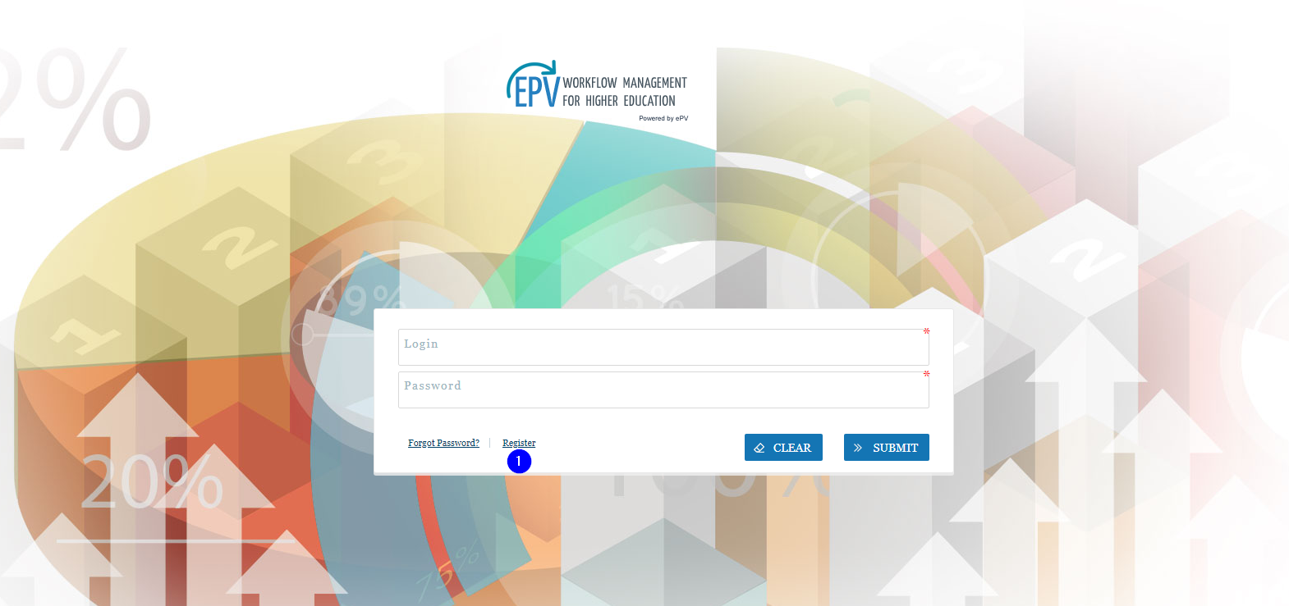

New User Registration
Notes:
Click the ‘Register’ link to create your profile

Slide 2
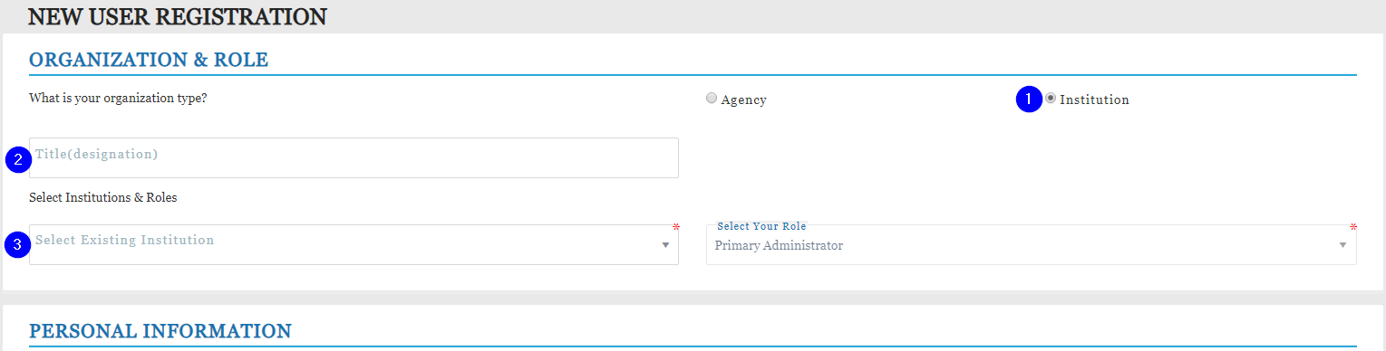
New User Registration Pt. 1
Organization & Role
-Click the button next to ‘Institution’
-Fill in your title (i.e. Director of IR, Registrar)
-Use the drop down menu to select your institution
-Your role will be set to Primary Administrator
Notes:
Organization & Role
-Click the button next to ‘Institution’
-Fill in your title (i.e. Director of IR, Registrar)
-Use the drop down menu to select your institution
-Your role will be set to Primary Administrator. The P.A. will create all other user profiles.

Slide 3
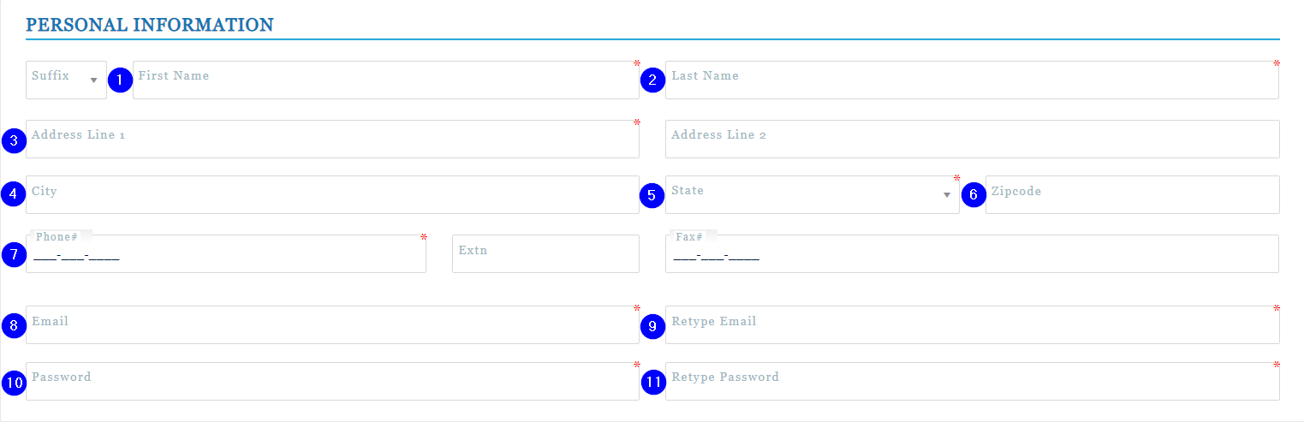
New User Registration Pt.2
Personal Information-The following fields are required to create your profile
-Enter first name, last name
-Institution address, state, zip code
-Phone number
-Email address & password
Notes:
Personal Information-The following fields are required to create your profile
-Enter first name
-Last name
-Institution address
-Phone number
-Email address
-Password

Slide 4
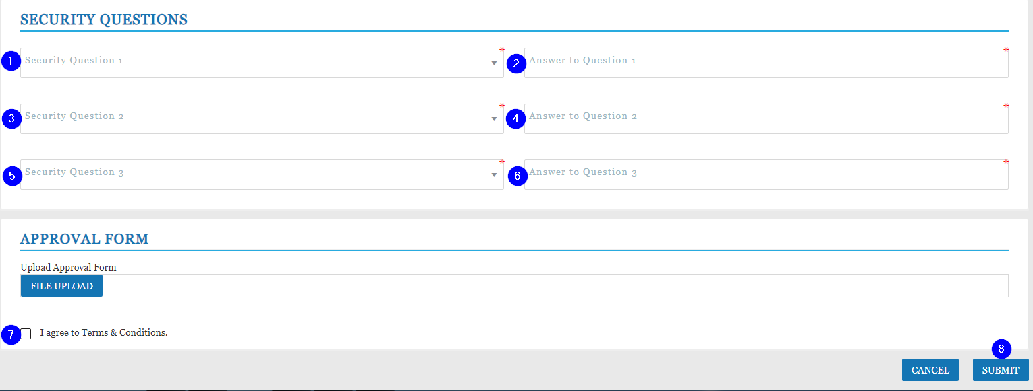
New User Registration Pt. 3
Security Questions – Fill in all three
Approval Form – PA needs to be completed and uploaded
https://www.ibhe.org/iheis.html
Be sure to click to agree to the Terms & Conditions
Click ‘Submit’ button in the bottom right corner
Notes:
Security Questions
-Use the drop down menus to select your security questions
-Enter your responses to the security questions
Approval Form (on file for the current Primary Administrators)
Terms & Conditions
-Be sure to click to agree to the Terms & Conditions
Click ‘Submit’ button in the bottom right corner

Slide 5
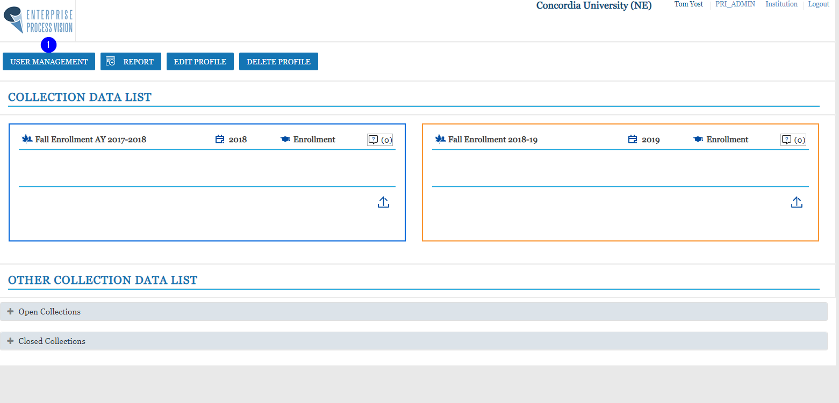
Adding Users
Notes:
Click on the ‘User Management’ tab

Slide 6
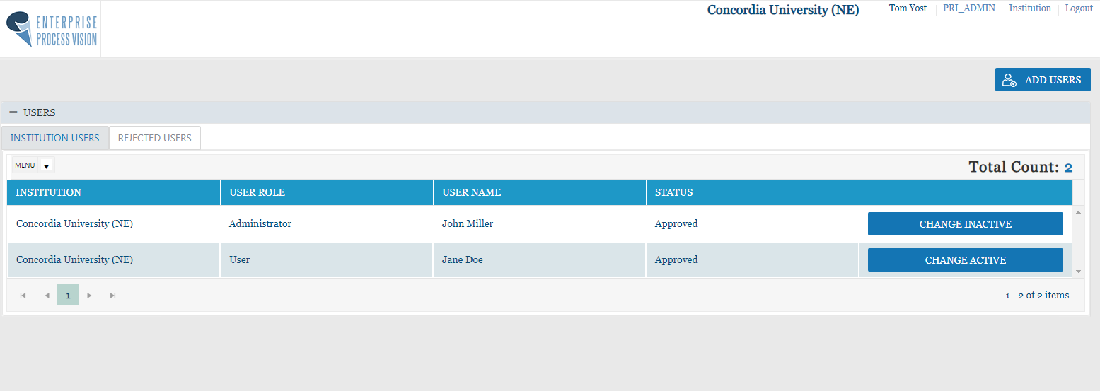
User Management

Slide 7
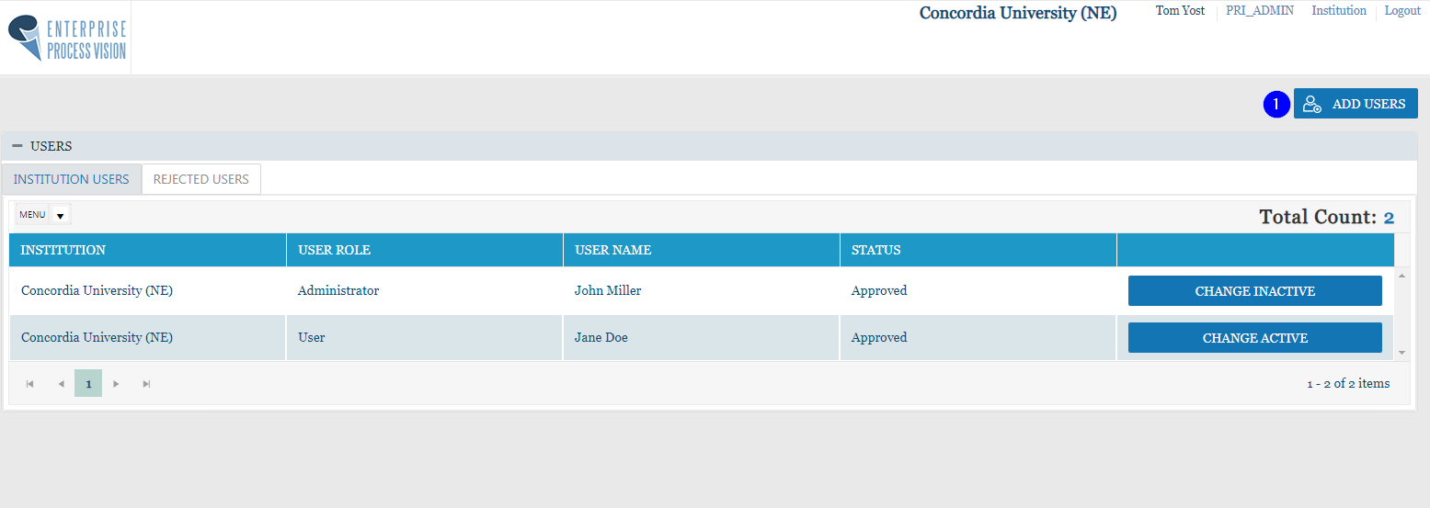
User Management
Click ‘Add Users’ to create a new user profile
Notes:
Click ‘Add Users’ to create a new user profile

Slide 8
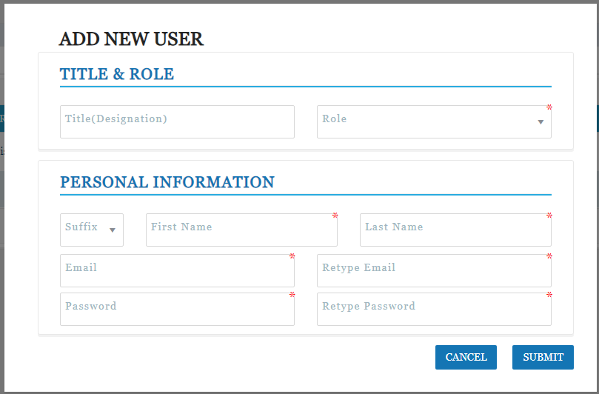
Adding New Users

Slide 9
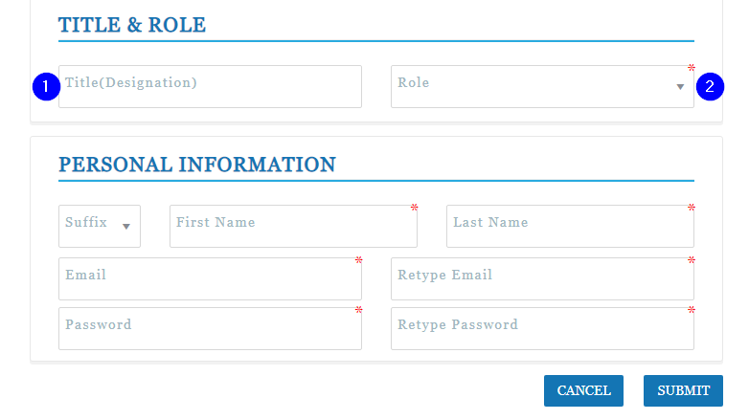
Adding New Users Pt. 1
Adding New Users
-Enter new user title
Notes:
Adding New Users
-Enter new user title

Slide 10
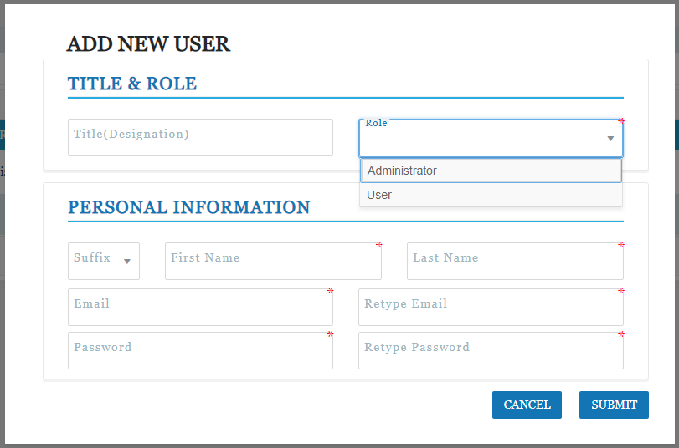
Adding New Users Pt. 1
Notes:
Adding New Users
-Use drop down menu to assign the new user’s role

Slide 11
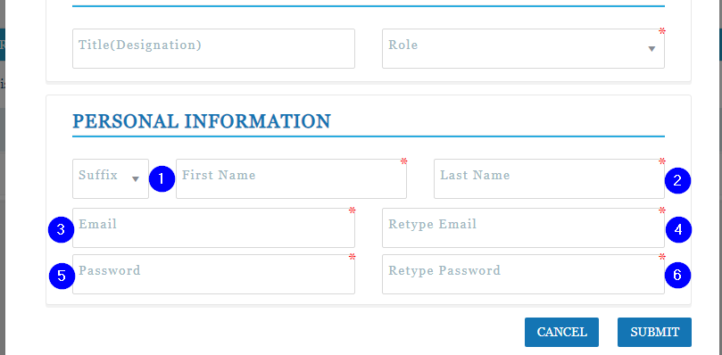
Adding New Users Pt. 2
-Enter new user’s first name, last name, email address, password
-Click ‘Submit’
Notes:
Adding New Users
-Enter new user’s first name, last name, email address, password
-Click ‘Submit’

Slide 12
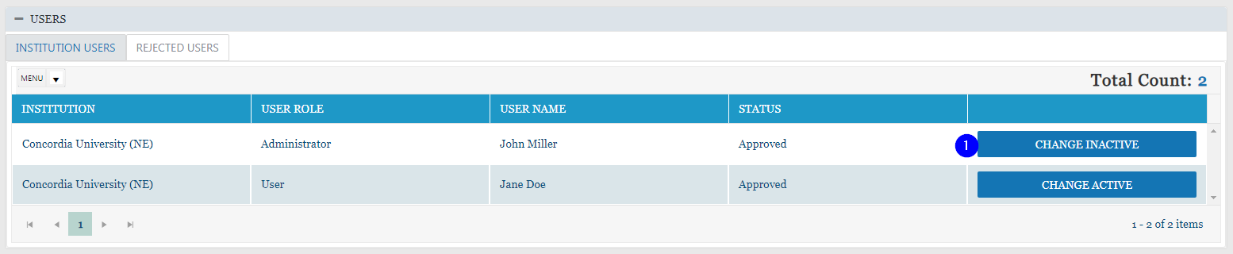
User Status Change
Click ‘Change Inactive/Active’ button
Notes:
Click ‘Change Inactive/Active’ button

Slide 13
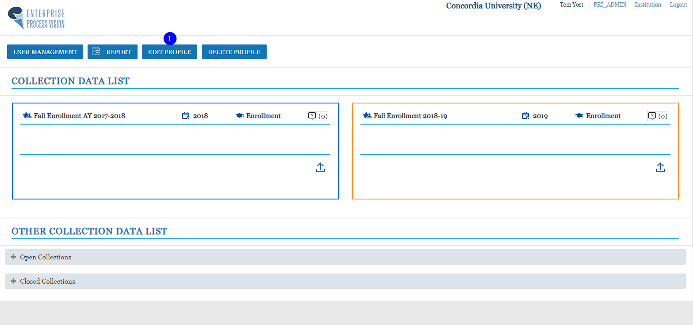
Edit Profile
Notes:
Click the ‘Edit Profile’ tab

Slide 14
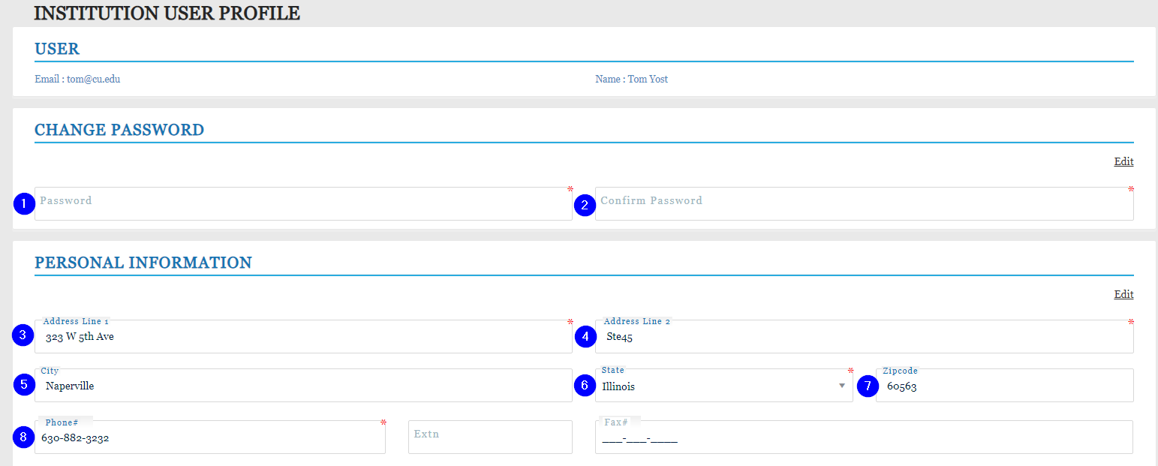
Edit Profile Pt. 1
Change Password
-Enter and confirm new password
Change Personal Information
-Edit address and phone number
Notes:
Edit Profile Pt. 1
Changing Password
-Enter new password and confirm new password
Change Personal Information
-Edit address and phone number

Slide 15
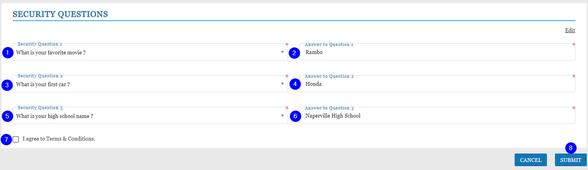
Edit Profile Pt. 2
-Changing Security Questions
-Use drop down menus to select three security questions
-Enter unique responses to security questions
-Be sure to agree to Terms& Conditions
-Click ‘Submit’
Notes:
-Changing Security Questions
-Use drop down menus to select three security questions
-Enter responses to security questions
-Be sure to agree to Terms& Conditions
-Click ‘Submit’

Slide 16
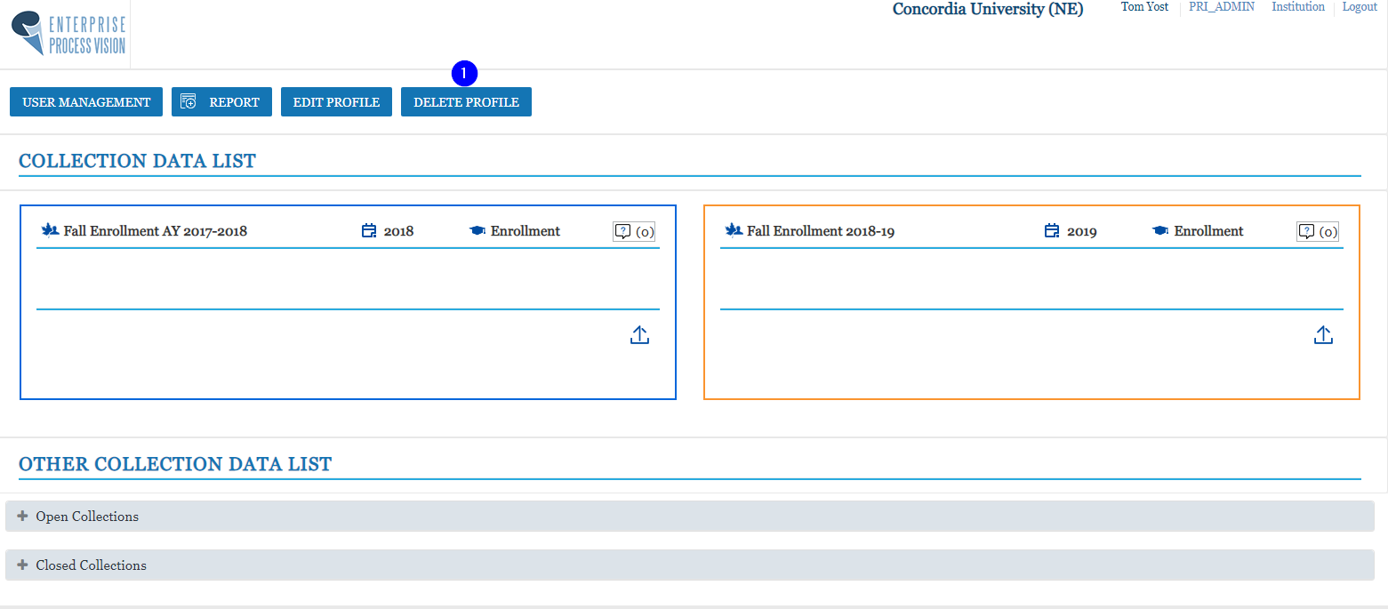
Deleting Profiles
Click ‘Delete Profile’ tab
Notes:
Click ‘Delete Profile’ tab

Slide 17
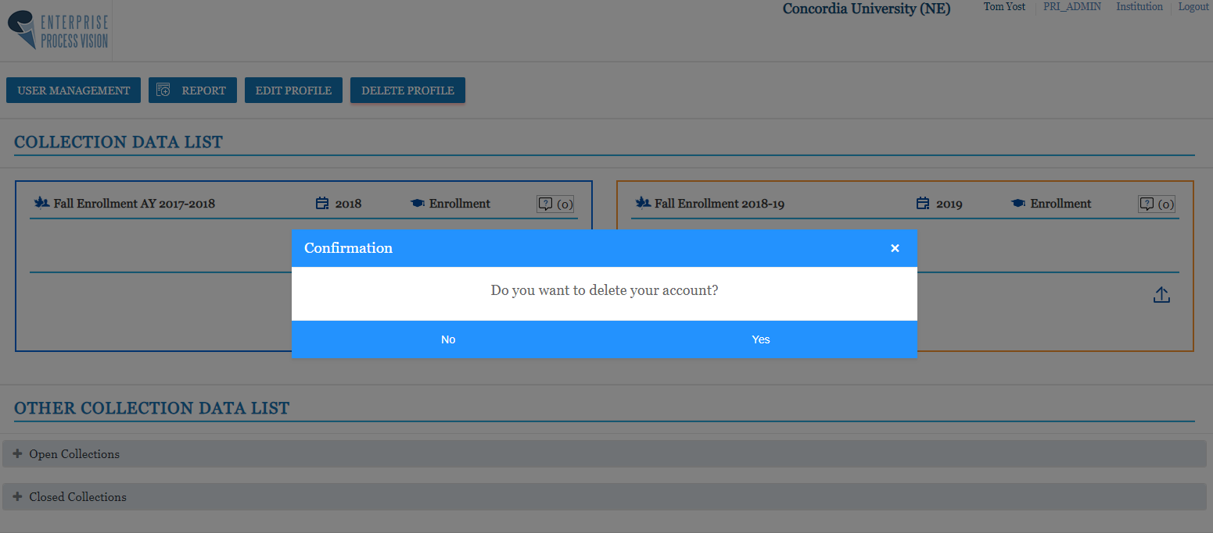
Deleting Profiles
Click ‘Yes’ or ‘No’ to confirm
Notes:
Click ‘Yes’ or ‘No’ to confirm

